Slide 1
Information Processing Family Model
Leighann Davidson
Josh Cooper
Lauren Hutchinson
Abdelhak Haffoudhi

Slide 2
INFORMATION Processing
Cognitive processes
Sensory memory
Working memory
Long-term memory

Slide 3
CONCEPT ATTAINMENT "WHAT IS A CONCEPT. AND WHAT IS MEANT BY KNOWING A CONCEPT?"

Slide 4
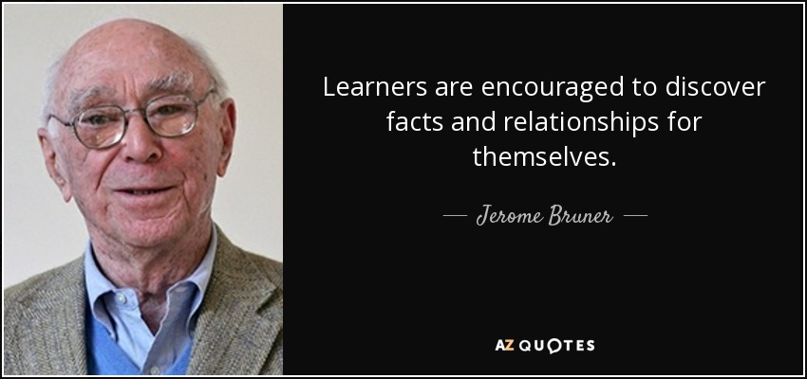

Slide 5
Jerome S. Bruner, Jacqueline J. Goodnow, and the late George A. Austin developed the idea of concept attainment in their book A Study of Thinking (1956)
A concept is “The network of inferences that are or may be set into play by an act of categorization” (Bruner, Goodnow, and Austin 1956, 244).

Slide 6
Concept Attainment
Phase One
Phase Two
Phase Three
Teacher presents examples.
Students compare attributes.
Students generate and test hypothesis.
Students state a definition to the essential attributes.
Students identify unlabeled examples.
Teacher confirms hypotheses, names concepts, and restates definitions of the essential attributes.
Students generate examples.
Students describe thoughts.
Students discuss role of hypotheses and attributes.
Students discuss type and number of hypotheses.

Slide 7
Strategies of Concept Attainment
Several models of teaching have been developed from the work of bruner and his colleagues. The purposes of these strategies include
To understand the nature of concepts-to help students see that objects, ideas, and events are distinguished by attributes and placed into categories;
To be more effective in attaining concepts, by understanding the thinking strategies being employed and by finding out the basis of the categories other people use to organize their environment;
To teach specific concepts; and
To become more aware of conceptualizing activity and to employ it at will, especially with unorganized data.

Slide 8
Concept Attainment
Advantages
Clarifies Ideas and Introduces New Concepts
Concepts Can Be Learned Thoroughly
Explore Difficult and Abstract Concepts
Concepts Can Be Applied/Related to The Real World
Build Off of Current Knowledge
Disadvantages
Students May Get Bored If They Understand While Waiting For Others to Make Connections
Concepts May Be Too Difficult
Motivation for Learning Diminishes
Requires A Lot of Pre-Planning

Slide 9
Synectics

Slide 10
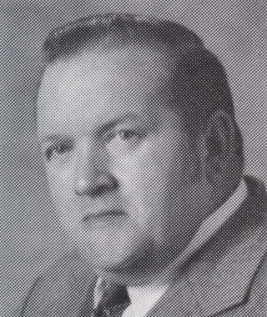
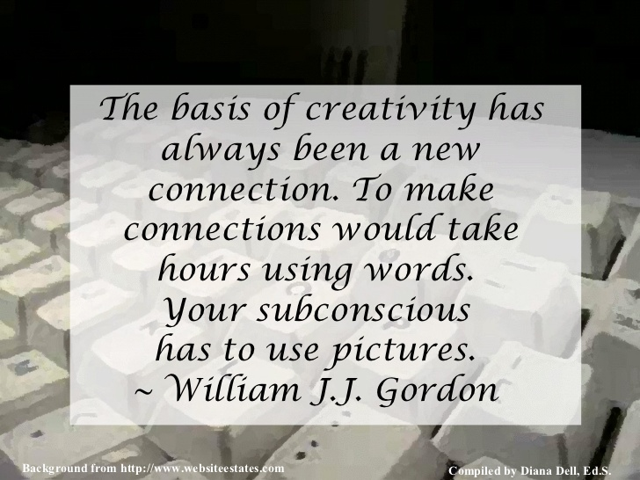
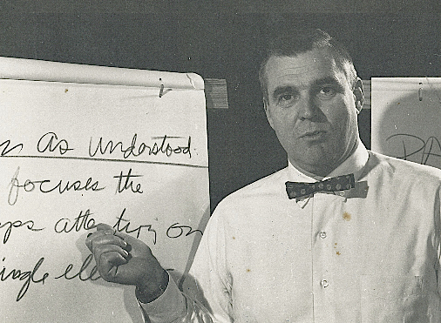

Slide 11
“To achieve radical new approaches to old problems it is essential to take ‘psychological chances,’ to abandon familiar ways of looking at things, even to transcend one’s image of oneself.”
“The Synectics Process involves making the strange familiar and the familiar strange.”
WILLIAM J.J. GORDON, FOUNDER OF SYNECTICS
“Another word for creativity is courage”
“One of the objectives of Synectics processes and skills is to turn competitive energy into cooperative energy and thus make available more of the creative potential that resides in each of us.”
GEORGE PRINCE, FOUNDER OF SYNECTICS

Slide 12
Synectics for Creating Something New
Phase One
Phase Two
Phase Three
Direction of the Present Condition
Direct Analogy
Personal Analogy
Phase Four
Phase Five
Phase Six
Compressed Conflict
Direct Analogy
Reexamination of the Original Task

Slide 13
Synectics for Making the Strange Familiar
Phase One
Phase Two
Phase Three
Substantive Input
Direct Analogy
Personal Analogy
Phase Four
Phase Five
Phase Six
Comparing Analogies
Explaining Differences
Exploration
Phase Seven
Generating Analogy

Slide 14
Steps of Synectics
Describe the topic: the facilitator selects a word or topic then asks students to describe the topic.
Create direct analogies: the facilitator selects another word or topic then asks the students to generate a list that would have the same characteristics as those words or phrases listed in step 1.
Describe personal analogies: have students select one of the direct analogies and create personal analogies.
Identify compressed conflicts: ask the students to pair words from the list generated in step 3 which seem to fight each other.
Create a new direct analogy: with the compressed conflict pair voted upon by the students, ask them to create a different direct analogy by selecting something that is described by the paired words. Ask the students to choose the ‘best’ one.
Reexamine the original topic: return to the original idea or problem so that the student may produce a product or description that utilizes the ideas generated in the process. They may concentrate on the final analogy or use analogies created in the other four steps.

Slide 15
Synectics
Advantages
Increased Understanding About A Particular Topic
Enhances Ability To Apply Knowledge
Fosters New Ideas
Learners Discover What They Already Know
Promotes Creativity
Assists In Retaining New Information
Disadvantages
More Demanding Than Brainstorming
Involves Multiple Steps
Process Can Be Complicated
Process Can Be Cumbersome
Requires More Time Than Other Brainstorming Processes
Requires More Effort Than Other Processes

Slide 16
Synectics Activity

Slide 17
Advance Organizers “Provide a structure or scaffolding that allows students to organize information”

Slide 19
First introduced by david ausubel in1960 as a practical application of his theory of meaningful verbal learning
Advance Organizers are different from overviews and summaries which simply emphasize key ideas and are presented at the same level of abstraction and generality as the rest of the material. Organizers act as a subsuming bridge between new learning material and existing related ideas.

Slide 20
Advance Organizers
Phase One: Presentation of Advance Organizer
Phase Two: Presentation of Learning Task or Material
Phase Three: Strengthening Cognitive Organization
Clarify aims of the lesson.
Identify defining attributes.
Give examples.
Provide context.
Prompt awareness of learner’s relevant knowledge and experience.
Present material.
Maintain attention.
Make organization explicit.
Make logical order of learning material explicit.
Use principles of integrative reconciliation.
Promote active reception learning.
Elicit critical approach to subject matter.
Clarify.

Slide 21
Principles of Advance Organizers
The most general ideas of a subject should be presented first and then progressively differentiated in terms of detail and specificity.
Instructional materials should attempt to integrate new material with previously presented information through comparisons and cross-referencing of new and old ideas.

Slide 22
Advance Organizers
Advantages
Structure The Near And Distance Learning Environment.
Students Are Prepared For Class And Never Behind.
Students Comprehend Content Presented By The Instructor More Quickly.
Engage All Students Equally.
Students Share Their Knowledge And Experiences With Each Other.
Students Share And Learn Different Perspectives
Disadvantages
Grading Large Number Of Assignments.
Students Complain About “Busy Work”.
Instructor Must Be A Good Facilitator To Ensure All Groups Share Their Discussion.
Students Prefer Passive Learning.
Some May Argue That Advance Organizers Are Effective For Elementary Education, But Not Adult Learners.

Slide 23
Memorization & Cognitive Growth

Slide 24
Memorization & Cognitive Growth
“I emphasize to C.E.O.s, you have to have a story in the minds of the employees. It's hard to memorize objectives, but it's easy to remember a story.”
Ben Horowitz

Slide 25
Memorization & Cognitive Growth
1. Orientation To The Model:
“The Link-Word Method”
“Other Memory-Assist Methods”
2. Concept About Memory:
Awareness
Association
Link System
Ridiculous Association
Substitute-Word System
Key Word
3. The Model of Teaching
4. Syntax
5. Application
6. Instructional and Nurturant Effects

Slide 26
Memorization
Let’s play a memory game:
Youtube link to video goes here: https://www.youtube.com/watch?v=jev9nR6I59Y

Slide 27
Memorization & Cognitive Growth
Memorization in relation to Cognitive Growth
In this section, I am planning on linking memorization to cognitive growth… (I’m still working on this section)

Slide 28
INQUIRY TRAINING/ SCIENTIFIC INQUIRY

Slide 29
Focus
Linked to concepts and principles developed in cognitive psychology
Tests used are being modified to consider mental processing skills
Intellectual Development—based on the cognitive developmental theory of Jean Piaget
Inquiry Training/Inductive Thinking--focus on concept formation, interpretation of data, and formation of principles and theories
Concept Attainment--focus on categorizing, concept formation, and concept attainment

Slide 30
Inquiry Training
Assumptions
Thinking can be taught
Thinking is an active transaction
Thinking evolves by a rational sequence
Inductive Thinking Skills
Concept Formation
Interpretation of Data
Application of Principles

Slide 31
Scientific Inquiry
Scientific Method
Observation/Question/Problem
Research
Hypothesis
Design and Perform Experiment/Test Hypothesis
Collect and Organize Data
Draw Conclusions
Share Results

Slide 32
Inductive thinking

Slide 33
Inductive Thinking
Develops classification skills and hypothesis creation and testing.
Reverses traditional lessons.
Introduces data first and requires students to make connections.

Slide 34
Key aspects of inductive thinking
Thinking inductively – Each experience should help students learn more effectively by improving their ability to use information and construct knowledge.
Inquiring collaboratively – Students must learn to build and test ideas with others.
Use learning resources – Students need to learn to find information in books and on the web.
Building conceptual control – Students must organize, group and regroup information in an area of study.
Acquiring and retaining information – Things are more likely to stay learned if students organize data, create and test hypotheses and use that information to build skills.

Slide 35
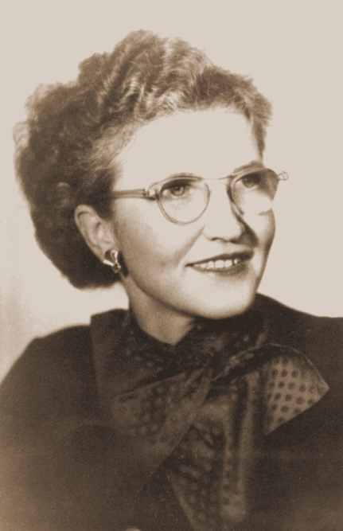
Hilda Taba

Slide 36
Hilda TABA
Came to USA after to complete postgraduate work in 1926 from Tartu University
Studied at Bryn Mawr College for Women.
PhD from Columbia University.
Curriculum Development. Theory and Practice (1962)
Focused on the development of reasoning with the Taba Rationale.
Viewed primary role of teacher as asking stimulating questions.
(Laanemets & Kalamees-Ruubel, 2013)

Slide 37
Types of Inductive Thinking Methods
inquiry-based learning
problem-based learning
discovery learning
Case-based learning
Discovery learning
Just in time teaching

Slide 38
Inductive Thinking
Literature demonstrates that inductive methods encourage students to learn deeply (Ramsden, 2003) and serve as precursors to intellectual development (Felder and Brent 2004).
Allows students to practice probability and be wrong without penalty.
Provides students opportunities to identify patterns and make conclusions.
Limited opportunities.
Incorrect observations lead to misconceptions.

Slide 39
Mnemonics

Slide 40
Picture-word

Slide 41
References
Ausubel, D. (1978). In defense of advance organizers: A reply to the critics. Review of Educational Research, 48, 251-257.
Ausubel, D. P. (1960) The use of advanced organizers in the learning and retention of meaningful verbal material. Journal of Educational Psychology, 51, 267-272.
Ausubel, D., Novak, J., & Hanesian, H. (1978). Educational Psychology: A Cognitive View (2nd Ed.). New York: Holt, Rinehart & Winston.
Bruner, J.S., Goodnow, J.J. & Austin, G.A. (1956) A Study of Thinking. Chapman & Hall, Limited. London.
Gordon, William J. J. Synectics: The Development of Creative Capacity. New York: Harper & Row, 1961.
Laanemets, U., & Kalamee-ruubel, K. (2013). The Taba-Tyler Rationales. Journal of the American Association for the Advancement of Curriculum Studies, 9(2013). Retrieved from http://www.uwstout.edu/soe/jaaacs/upload/2013-05-1-urve.pdf
Prince, G.M. (1970) The Practice of Creativity. Macmillan, New York
Weil, J. & Joyce, B. (1978). Information models of teaching. Englewood Cliffs, NJ: Prentice Hall Inc.

